Slide 1
ONLINE BEHAVIORAL CUSTOMER SEGMENTATION
Done by
DHARMESH WARAN C

Slide 2
INTRODUCTION
Customer Segmentation is a methodology using which we can divide our customer base into group of individuals who are similar in terms of either gender, spending behavior, frequency to visit, age or other demographics. Customer segmentation allows companies to precisely target the customers who has a specific needs and desires.

Slide 3
COMPANY PROFILE
360digiTMG (Innodatatics)
We partner with clients to build innovative solutions for core business problems. Team at Innodatatics is constantly engaged in solving the problems of clients by closely working with them at each level.
Based on a survey, Data is going to grow manifold in the near future. It is quite complex to explore the hidden insights in the data. We at 360digiTMG put our world-class Innovative, Advanced & Robust Analytical capabilities comprising of descriptive, prescriptive, predictive analytics into action to build solutions using Open Source tools for cost effectiveness & efficiency. Data security is given the utmost priority.

Slide 4
OBJECTIVES OF STUDY
PRIMARY OBJECTIVE
Online behavioral customer segmentation with reference to 360digiTMG by using secondary data.

Slide 5
SECONDARY OBJECTIVES
To create marketing strategies for each group of customers.
To find out the most effective channel e.g. coupons, price-off etc.
To find out the customers we must retain, based on total amount of purchase.
To find out the customer lifetime value.

Slide 6
NEED FOR THE STUDY
Behavioral segmentation of different group of customers
To identify ideal customers to whom we can definitely sell
Target offers by various segments
To implement loyalty schemes

Slide 7
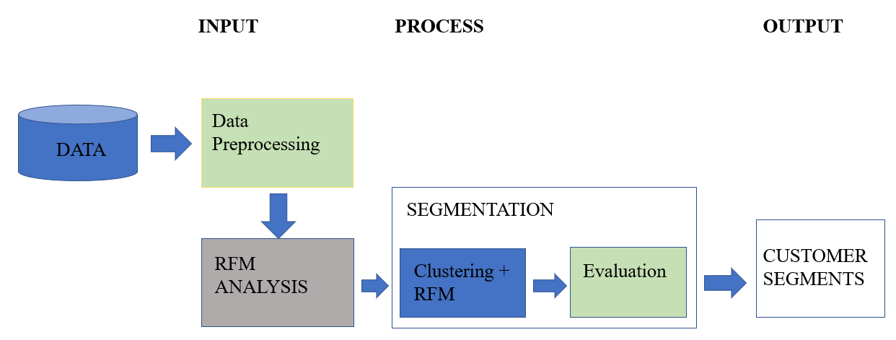
RESEARCH DESIGN

Slide 8
RESEARCH METHODOLOGY
Data Collection by secondary data
To ensure data is accurate and specific
Using statistical measures to identify the data patterns
To identify customer behavior
To identify the customer segments

Slide 9
RFM
RFM stands for Recency Frequency Monetary
RECENCY means how recently a customer purchased an product and product category?
The more the recent purchases the better the score would be
FREQUENCY represents how often a customer buys an product or item?
The more frequent the purchases the better the score would be
MONETARY represents how much the customer spent value?
The more the value the better the monetary score would be

Slide 10
DATA ANALYSIS TOOL
PYTHON PROGRAMMING

Slide 11
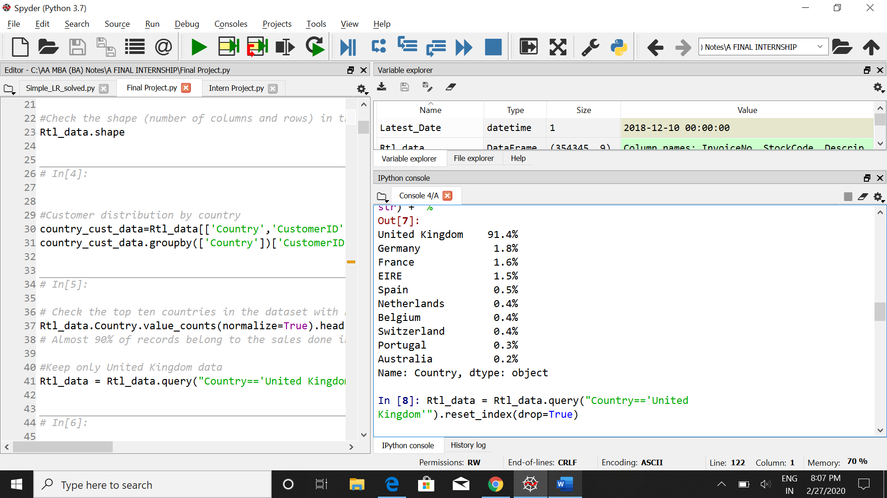
ANALYSIS

Slide 12
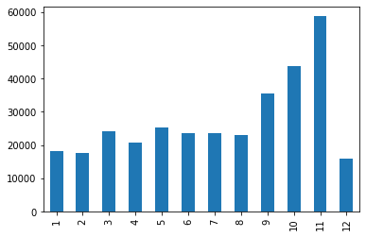
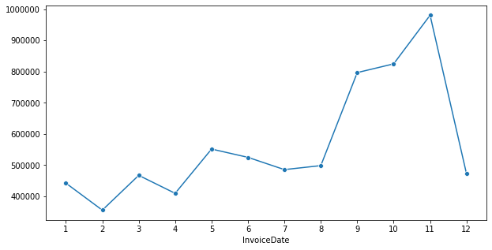

Slide 13
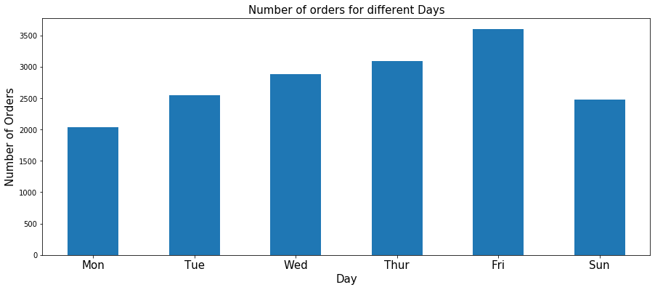

Slide 14
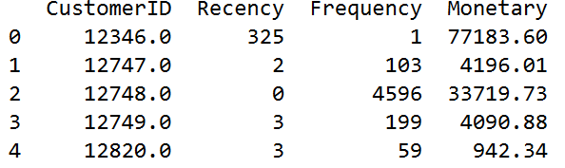
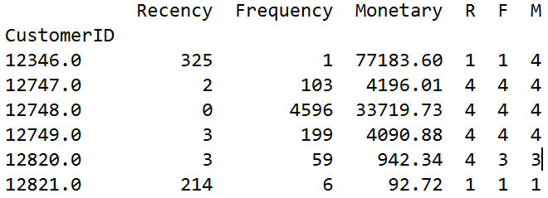
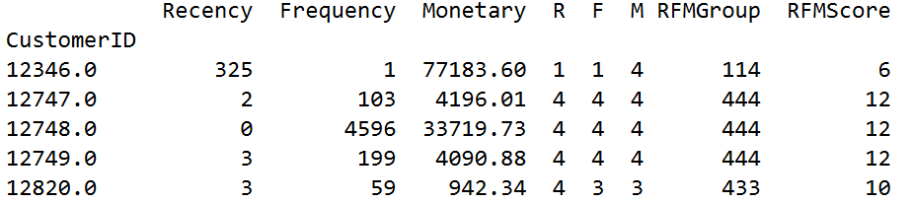

Slide 15
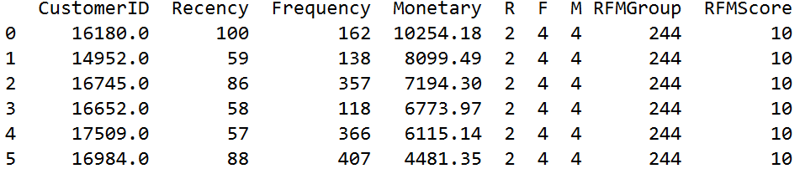
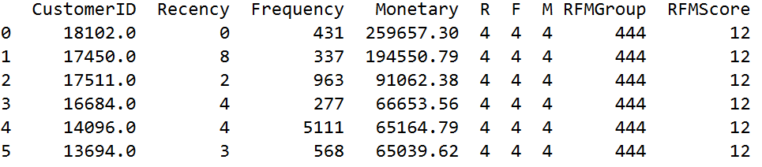
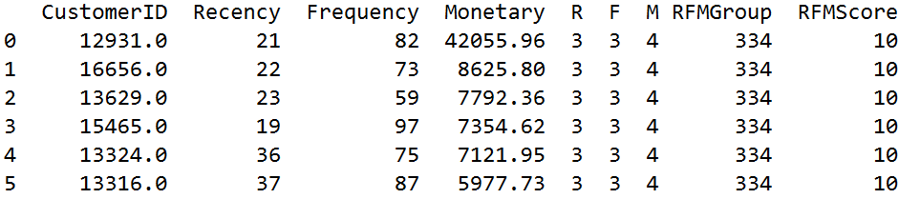
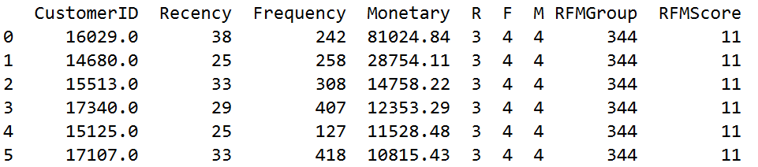
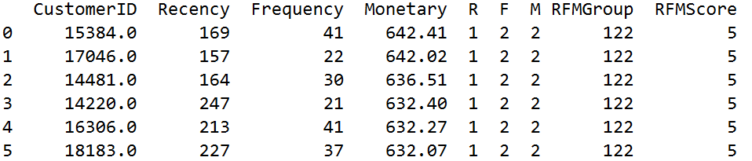
DIFFERENT COMBINATIONS OF RFM SCORES

Slide 16
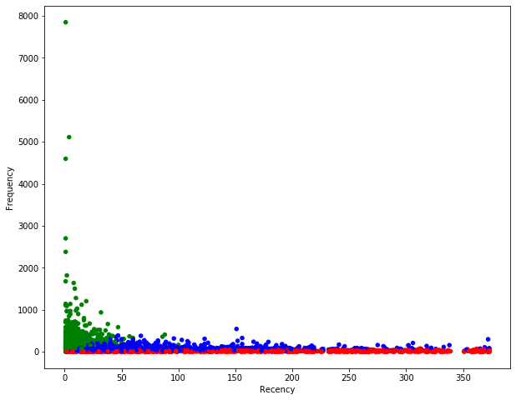
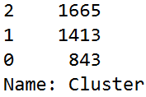
RED = Impulsive Customers (CL-1)
GREEN = MVP’s (CL-2)
BLUE = Loyal Customers (CL-0)

Slide 17
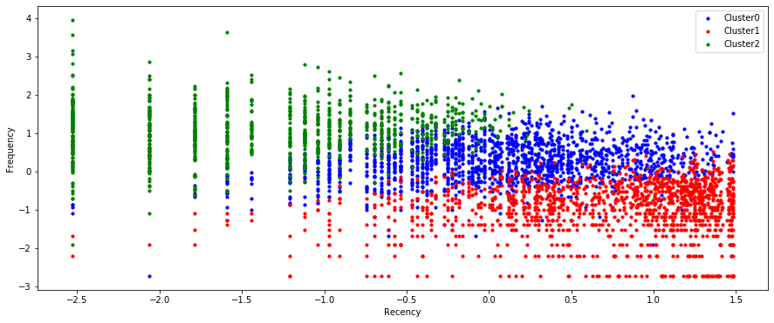
RECENCY Vs FREQUENCY

Slide 18
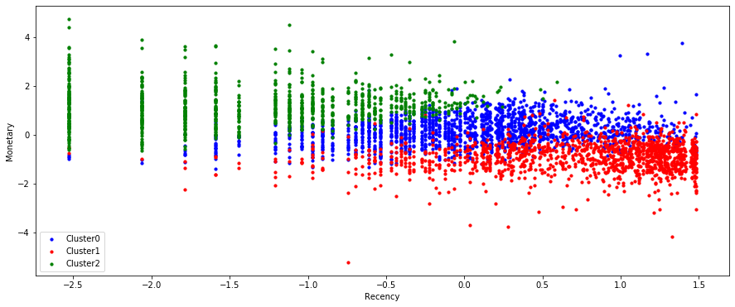
RECENCY Vs MONETARY

Slide 19
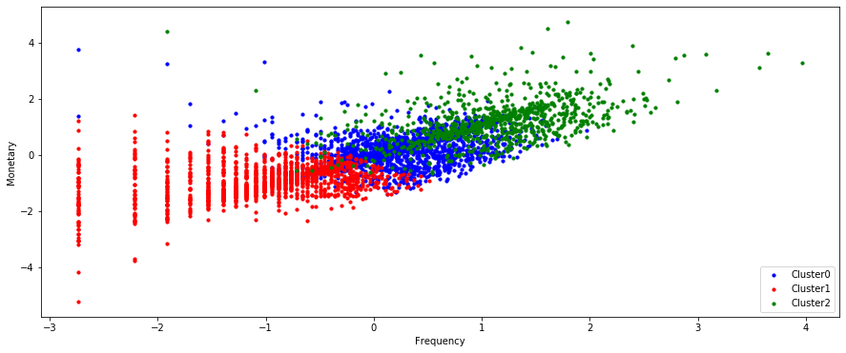
MONETARY Vs FREQUENCY

Slide 20
SUGGESTIONS
MVP Customers
Cross sell the products related to the product they purchase
Advertise our high value products
Upsell higher value products
They can easily become early adopters for new products and can recommend to others prospects
These loyal customers need to be given a discounted price
Increase the customers spent through value added offers based on previous purchase
These customers have proven to have a higher willingness to pay, so no need to use discount pricing to generate incremental sales.

Slide 21
Loyal Customers
Customers in this segment is most likely be our newest customers as they have a high recency, low frequency and low monetary value
Building relationship with this customers by providing onboarding support
Providing special offers to increase their visits
Make limited offers, based on past purchases
Giving Price incentives to these group of customers

Slide 22
Impulsive customers
Customers falling into RFM Group like 111 (Inactive or least buying)
Conduct surveys to find out what went wrong and avoid losing them
Send personalized emails to get them back
No need to spend too much to re-acquire
Company may try to offer some reward to these group of customers
Aggressive Price incentives
Offer other relevant products and special discounts.

Slide 23
CONCLUSION
RFM is a data driven customer segmentation technique that allows marketers to take tactical decisions. It empowers marketers to quickly identify and segments users into homogeneous groups and target them with differentiated and personalized marketing strategies. This in turn improves user engagement and retention.
Constant improvements in data analytics have ensured that the practical application of models like RFM are seemingly endless. The RFM model ensures effective marketing practices in a world where creating a customer centric experience is of importance. Since segmentation is done based on the values of recency, frequency and monetary values, the company can customize their marketing strategies to the customers based on their buying behavior.

Slide 24
SCOPE FOR FURTHER STUDY
Future work includes
studying the performance of the customers in each segment such as the products which are bought frequently by the members of each segment. This would help better in providing better promotional offers to specific products.
Experimental results obtained using the US patent data show that recency, frequency, and monetary are efficient variables to identify the future core patents.

Slide 25
THANK YOU

